Slide 1
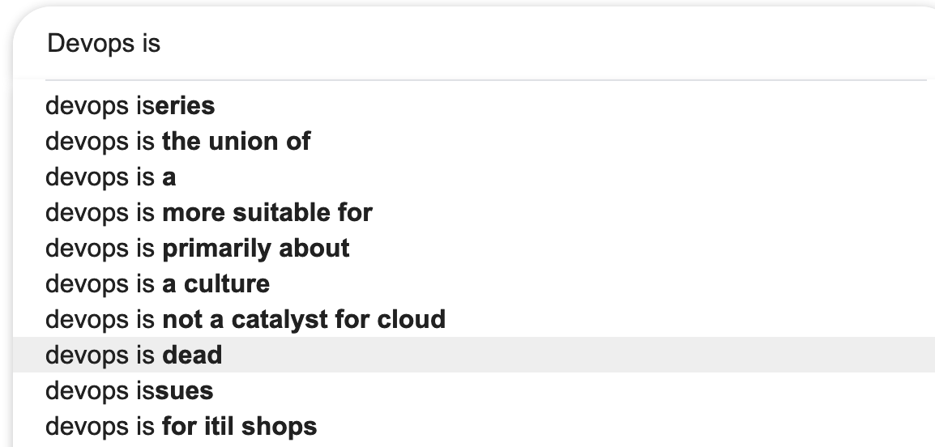
DevOps is

Slide 2
Tech-powered DevOps Acceleration

Slide 3
A brief DevOps Definition
Culture / Movement
Values
Software development practices
Toolset
Dev + Ops

Slide 4
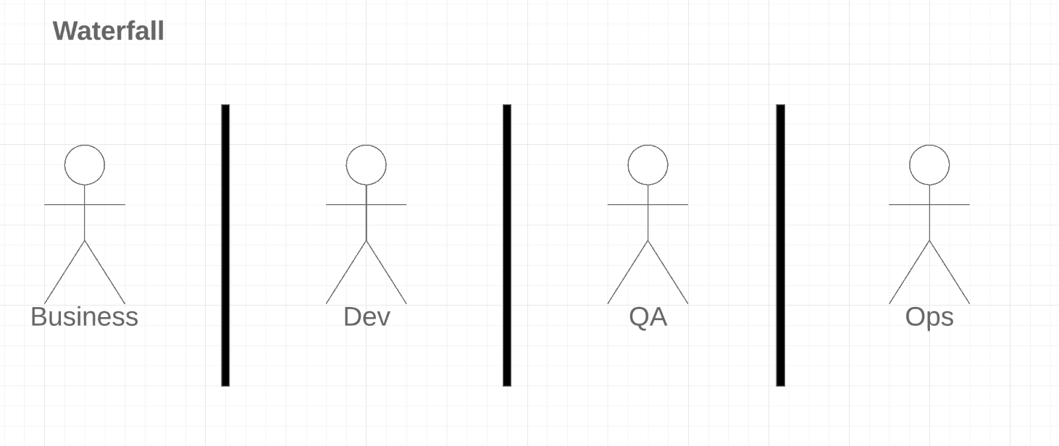
A brief DevOps Definition

Slide 5
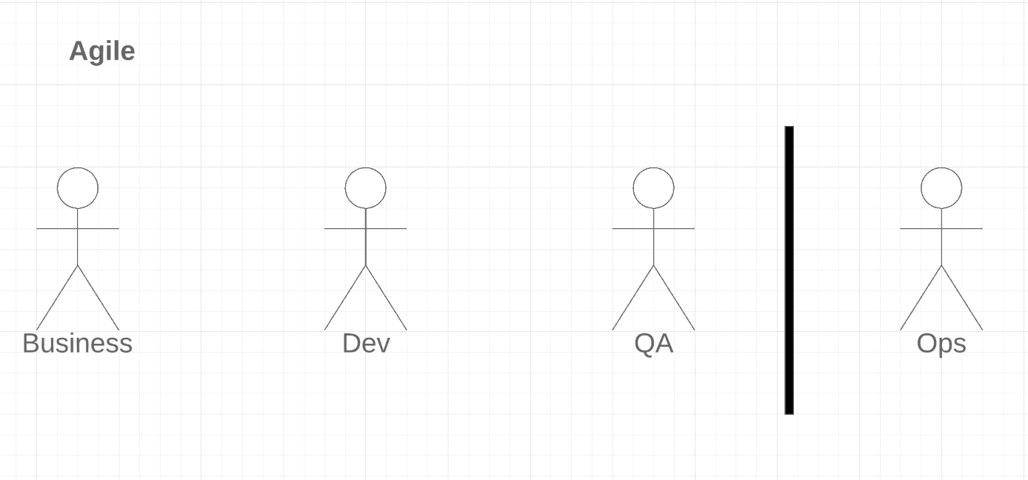
A brief DevOps Definition

Slide 6
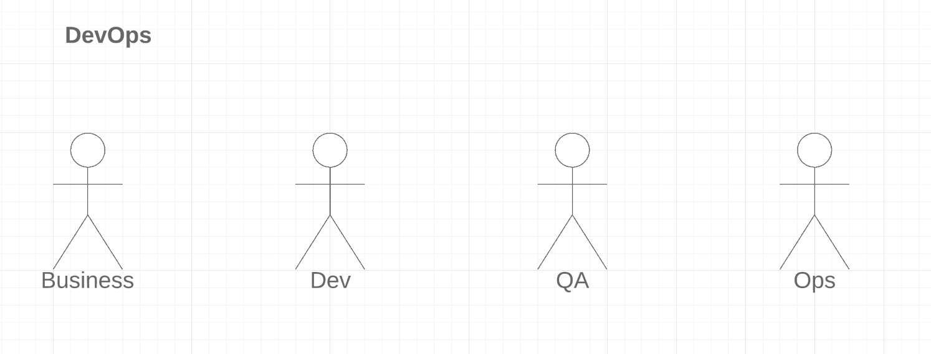
A brief DevOps Definition

Slide 7
A brief {x}Ops Definition
Dev + Data Science + Ops = DataOps
Dev + Infosec + Ops = DevSecOps
NoOps
ChatOps

Slide 8
If DevOps is so great, why are companies so afraid of it?

Slide 9
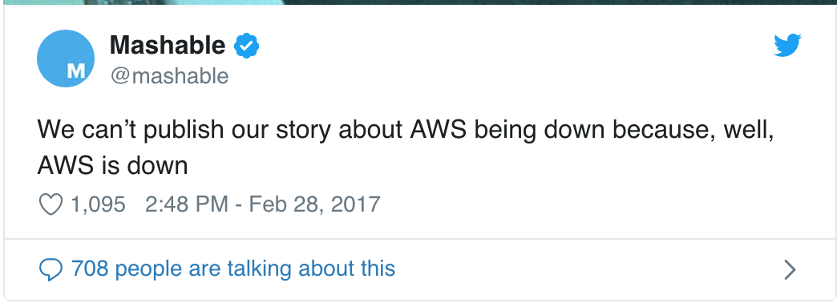
The ”broken promise” of DevOps

Slide 10
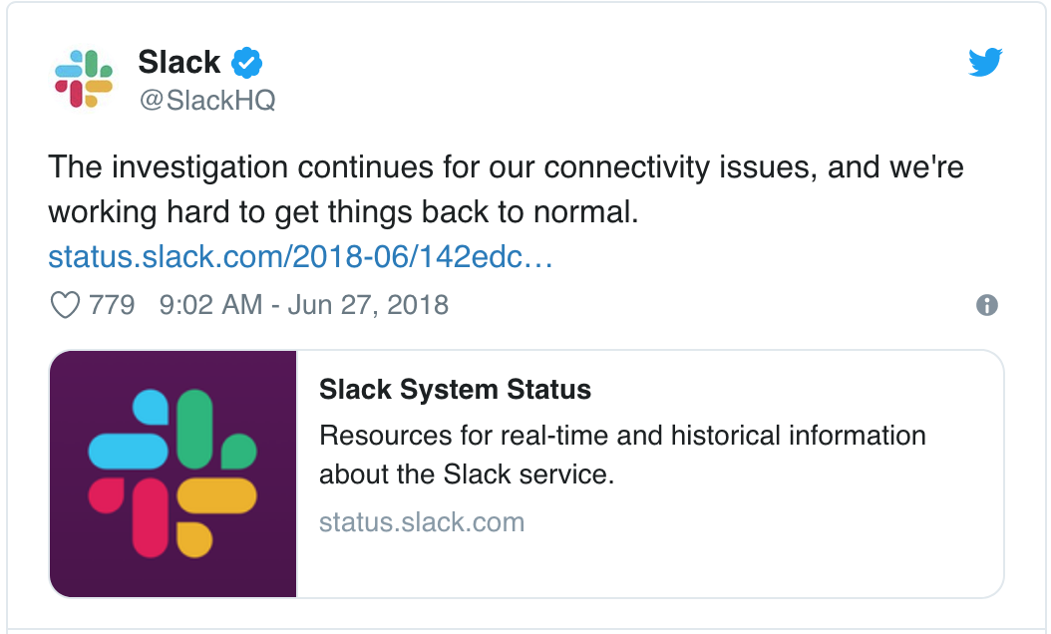
The ”broken promise” of DevOps

Slide 11
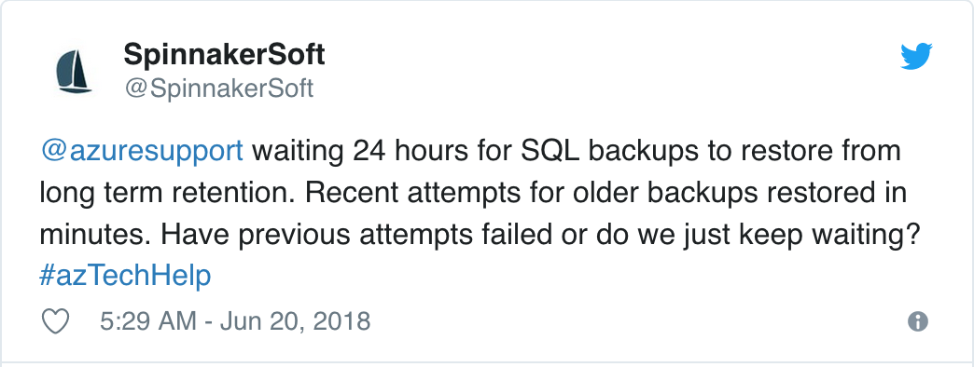
The ”broken promise” of DevOps

Slide 12
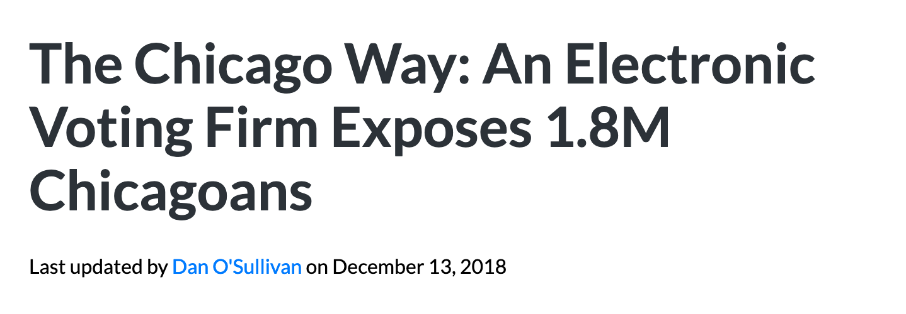
The ”broken promise” of DevOps

Slide 13
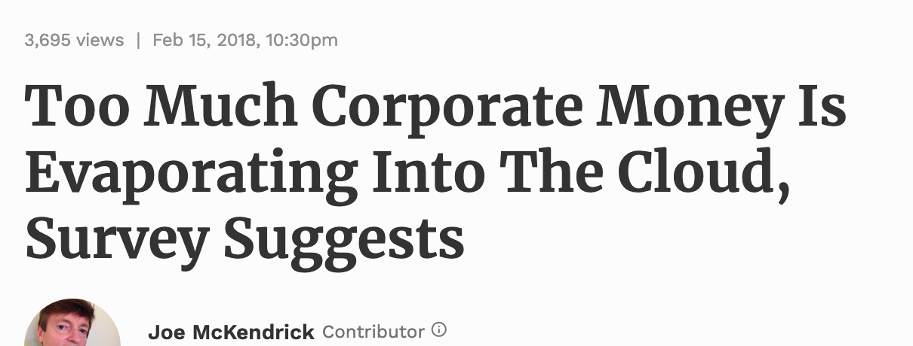
The ”broken promise” of DevOps

Slide 14
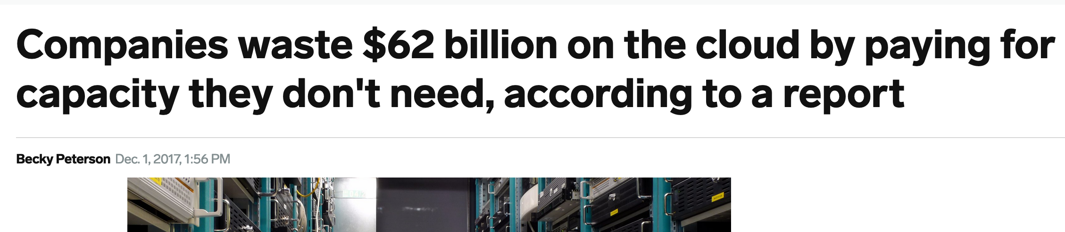
The ”broken promise” of DevOps

Slide 15
The ”broken promise” of DevOps
Unmet Organizational Standards (or lack of)
Misalignment between Key Business Objectives and Technology
Tools, Processes, Practices are out-of-line
Bad DevOps = Broke Company

Slide 16
The ”broken promise” of DevOps
Gartner predicts that through 2022, 75% of DevOps initiatives will fail to meet expectations due to issues around organizational learning and change*
* https://www.gartner.com/smarterwithgartner/the-secret-to-devops-success/

Slide 17
One dimension of DevOps was never meant to fulfill that promise

Slide 18
Devops is not just culture

Slide 19
Devops is not just processes

Slide 20
Devops is not just tools

Slide 21
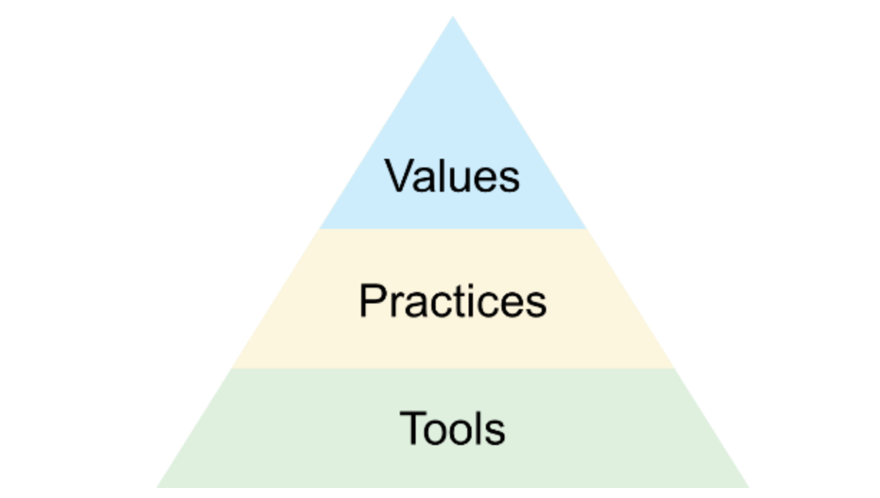
DevOps

Slide 22
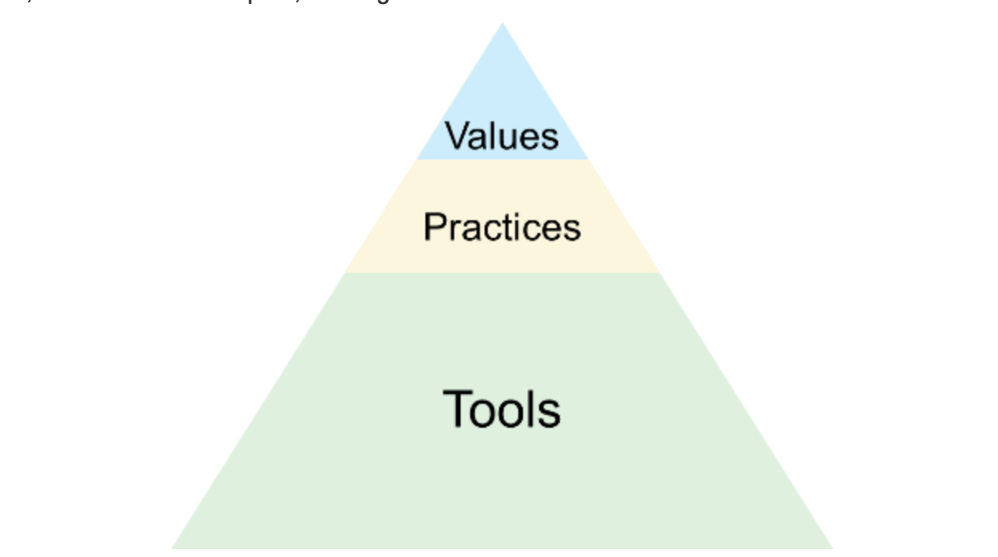
DevOps
*DevOps pyramid by dollars spent

Slide 23
DevOps
*DevOps pyramid by dollars spent and and how is actually prioritized

Slide 24
DevOps
Grounded in customer success and value
Contextualized to your organization
Realistic expectations based on available know-how and resources
Meant to empower teams, key business objectives, and organizational needs
Is just Agile!

Slide 25
The Value – Practice – Tool cycle

Slide 26
The Value – Practice – Tool Cycle
Feedback – Continuous Integration – Jenkins
Decreasing silos – Cross-functional teams – Slack/Jira/Boards
Automation – IaC /CM – Terraform/Ansible/Chef/Puppet
Continuous Learning – Continuous Deployment – GoCD / Spinnaker / Octopus Deploy / Electric Flow

Slide 27
Value-Practice-Tool is mean to help identify the benefit of using a particular tool or technology

Slide 28
Technology is meant to enable practices and processes, but those practices and processes should not come after technology*

Slide 29
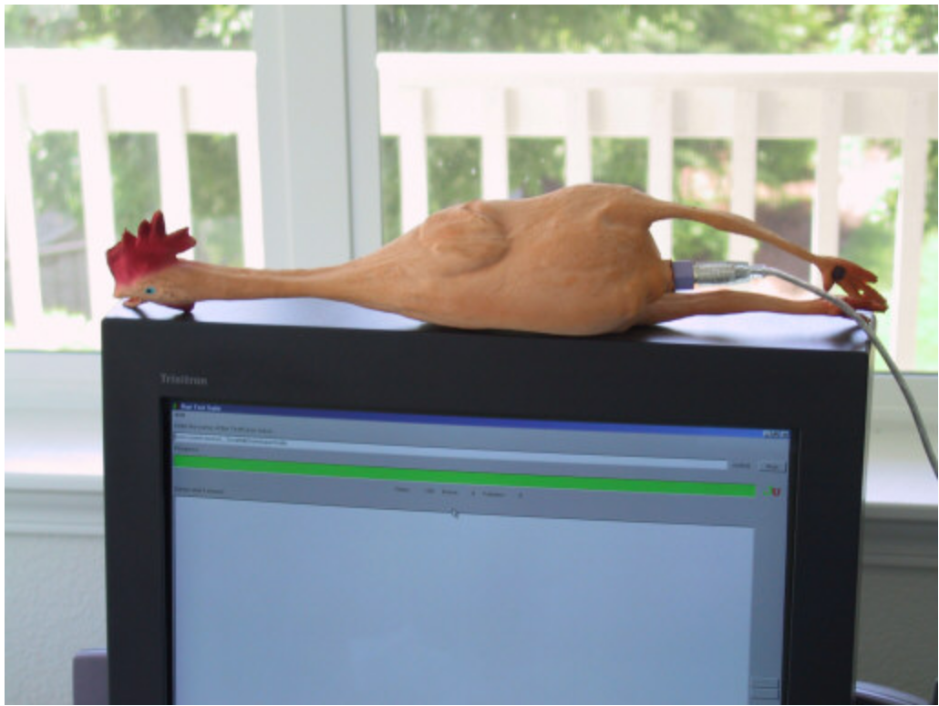
Example: Continuous integration
¹ https://www.jamesshore.com/Blog/Continuous-Integration-on-a-Dollar-a-Day.html
² Continuous Delivery: Reliable Software Releases through Build, Test, and Deployment Automation, Chapter 3

Slide 30
A real business case!
Data processing platform
PaaS model implemented with automatic provisioning using Terraform/Jenkins/Ansible

Slide 31
A real business case: IaC, PaaS, and Self Service platforms
Data processing platform
PaaS model implemented with automatic provisioning using Terraform/Jenkins/Python/Puppet
* Terraform-powered platform as a service: https://www.youtube.com/watch?v=WDeHX1w-z70

Slide 32

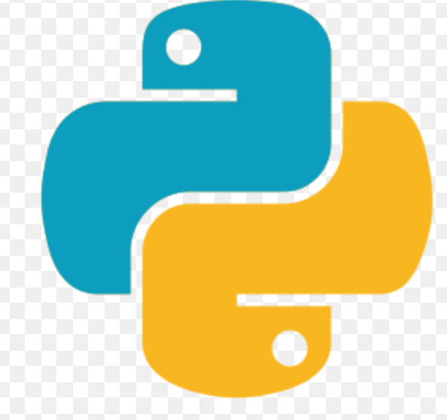

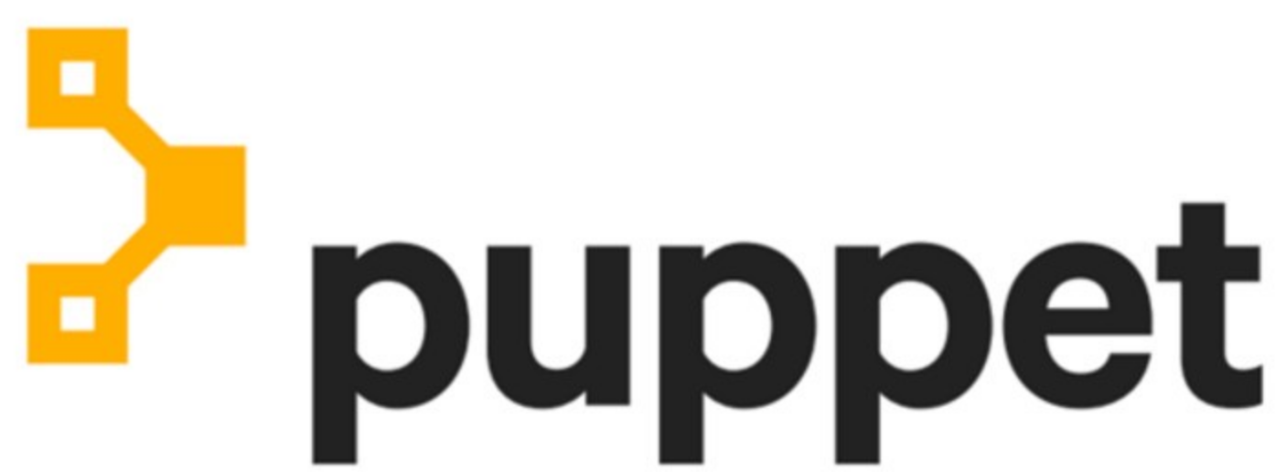
A real business case: IaC, PaaS, and Self Service platforms
Client Signs Up
TF Code Generated
Infra is Deployed
* Terraform-powered platform as a service: https://www.youtube.com/watch?v=WDeHX1w-z70

Slide 33
A real business case: IaC, PaaS, and Self Service platforms
The tooling orchestration allowed us to propagate the model and start implementing self service platforms (SRE Practice)
Shift Ops responsibility and reduce dependencies
Enable security
Operational Standards / Automate compliance
* Terraform-powered platform as a service: https://www.youtube.com/watch?v=WDeHX1w-z70

Slide 34
Other examples
The tooling orchestration allowed us to propagate the model and start implementing self service platforms
Shift Ops responsibility and reduce dependencies
Enable security
Operational Standards / Automate compliance
* Terraform-powered platform as a service: https://www.youtube.com/watch?v=WDeHX1w-z70

Slide 35
DevOps
…Grounded in customer success, key business objectives…

Slide 36
DevBizOps!!!!!

Slide 37
Now, seriously:
DevOps as an extension of agile has always been meant to keep the business in mind!

Slide 38
Feature lifecycle, current devOps way:
Business
Development
QA
Ops
Customers

Slide 39
Feature lifecycle, current devOps way:
?? ??
Business
Development
QA
Ops
Customers

Slide 40
Feature lifecycle, current devOps way:
Business
Development
QA
Ops
Customers

Slide 41
There’s flavor of DevOps for everyone, but you need to find it yourself!

Slide 42
DevOps Team Topologies

Slide 43

DevOps Team Topologies – The Netflix
Devs Ops
*https://web.devopstopologies.com/

Slide 44
DevOps Team Topologies – The Netflix
The "Netflix" approach or "no visible ops”
Ops fully embedded on dev teams
Most suited for single-product companies
*https://web.devopstopologies.com/

Slide 45
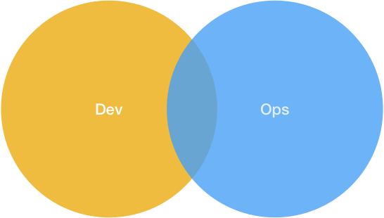
DevOps Team Topologies – Devs and Ops
*https://web.devopstopologies.com/

Slide 46
DevOps Team Topologies – Devs and Ops
Many dev teams, each working on a separate or semi-separate product stack
Enabled by the awareness dev and ops have of each other's needs and importance
Heavy culture shift!
Specializes when needed, shares when needed
*https://web.devopstopologies.com/

Slide 47
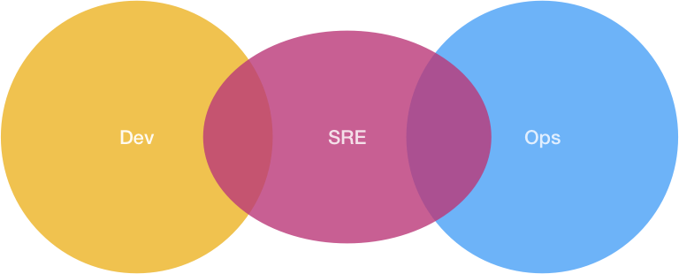
DevOps Team Topologies – The Google
*https://web.devopstopologies.com/

Slide 48
DevOps Team Topologies – The Google
The "Google" approach
Explicit hand-off from devs to ops
Strong operational standards are enforced by the devs
SRE rejects software if standards aren't met
HUGE Organizational & Engineering maturity
*https://web.devopstopologies.com/

Slide 49
Successful DevOps, at the end of the day
Business, Value, Customers FIRST!
DevOps is what DevOps means for your particular context
Roles/Skills don’t disappear, they barely transform
Team Awareness of the end to end responsibility is key
Nothing is set in stone, embrace openness, continuous learning and continuous improvement
Technology is good, but Values, Processes and Practices are as important in the whole equation
If our proposals can be linked to business success, they will be an easier sell

